Slide 1
Path Finding Algorithms: Implementation and Analysis
Milan Bista
University of Cumberlands
2024 Fall - Algorithms and Data Structures (MSCS-532-B01) - Second Bi-term
Instructors: Machica Mcclain / Vanessa Cooper
https://github.com/mbista25742/MSCS532_Project
Milan Bista: 2024 Fall - Algorithms and Data Structures (MSCS-532-B01)
Notes:
Path Finding

Slide 2
Path Finding Algorithms: Implementation and Analysis
Content:
What are Pathfinding Algorithms?
Understand the Basics of Graph Theory.
Different PathFinding Algorithms(BFS,DFS,Dijkstra, A*).
Visualization(Basic with 2D Grids).
Algorithm Optimization(BFS/DFS vs A*).
Visualization(with Python) And Analysis.
Future Research and Discussions.
Milan Bista: 2024 Fall - Algorithms and Data Structures (MSCS-532-B01)
Notes:
Path Finding

Slide 3
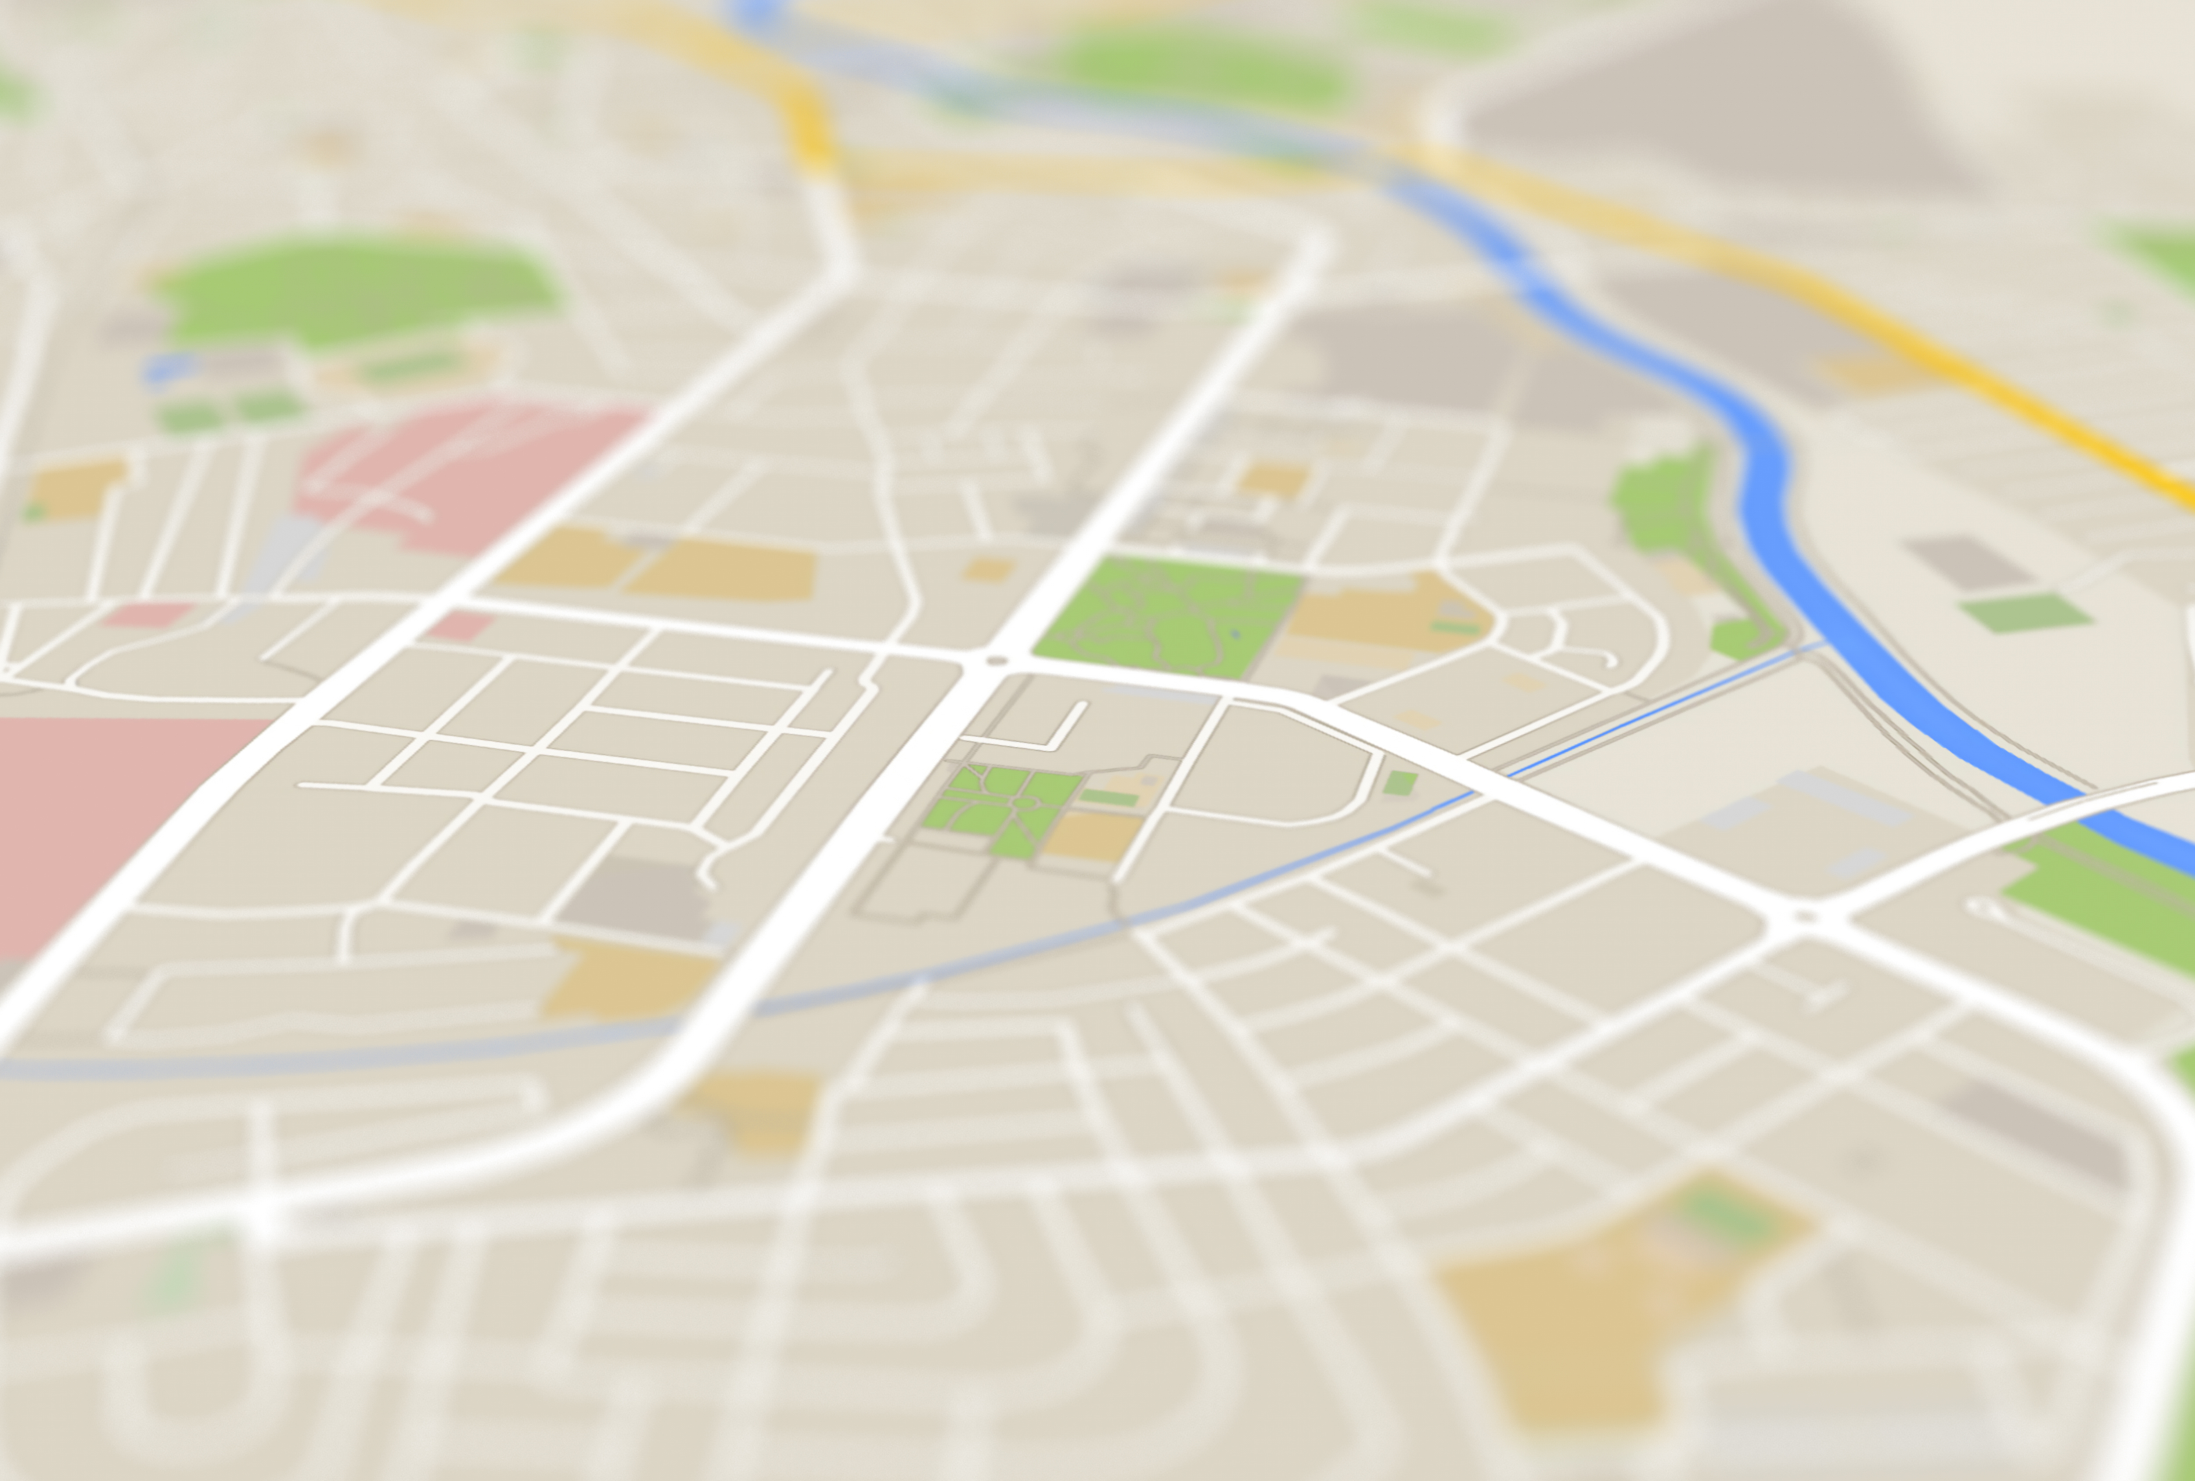
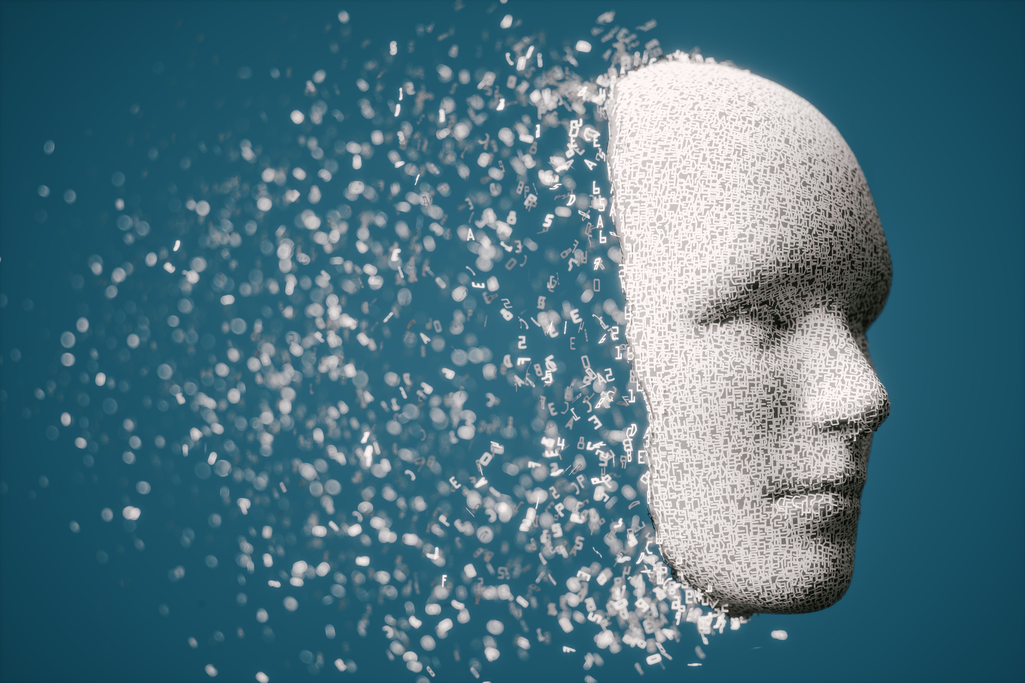

Path Finding Algorithms: Implementation and Analysis
What is Path finding Algorithm?
A pathfinding algorithm is a method used to find the shortest or most efficient route
from a starting point to a destination in a given space, often represented as a graph
or grid
Applications: GPS, Robotics, AI for Gaming, Routers, Social Media
Milan Bista: 2024 Fall - Algorithms and Data Structures (MSCS-532-B01)
Notes:
Path Finding

Slide 4
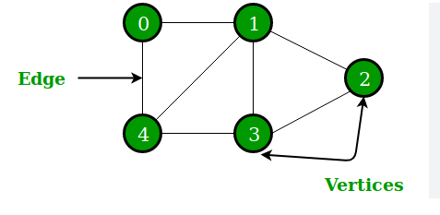
Path Finding Algorithms: Implementation and Analysis
Basic of Graph Theory:
A graph is a collection of nodes(vertices) and edges that connects those nodes.
Node: A node (also called a vertex) is a fundamental unit in a graph, representing an
entity or location
Edge: a line that connects nodes
Milan Bista: 2024 Fall - Algorithms and Data Structures (MSCS-532-B01)
Notes:
Path Finding

Slide 5

Path Finding Algorithms: Implementation and Analysis
Basic of Graph Theory:
Node: a building, your house, your neighbour’s house, a coffee shop
Edge: a road that connects your house to your neighbour’s house
Milan Bista: 2024 Fall - Algorithms and Data Structures (MSCS-532-B01)
Notes:
Path Finding

Slide 6
Path Finding Algorithms: Implementation and Analysis
Basic of Graph Theory:
Directed Graph: In a directed graph, edges have a direction, meaning they go from one node to
another. Each edge has a starting node and an ending node. E.g., One-way Street
Undirected Graph: In an undirected graph, edges do not have a direction. The connection between
nodes is bidirectional.. E.g., two-way Street
Weighted Graph: In a weighted graph, each edge has an associated weight or cost, which could
represent distance, time, or any other value. E.g., a highway speed of 60Miles/Hour, Toll Way
Unweighted Graph: An unweighted graph is a graph where edges have no associated weights.
All edges are treated equally.
And so on…
Milan Bista: 2024 Fall - Algorithms and Data Structures (MSCS-532-B01)
Notes:
Path Finding

Slide 7
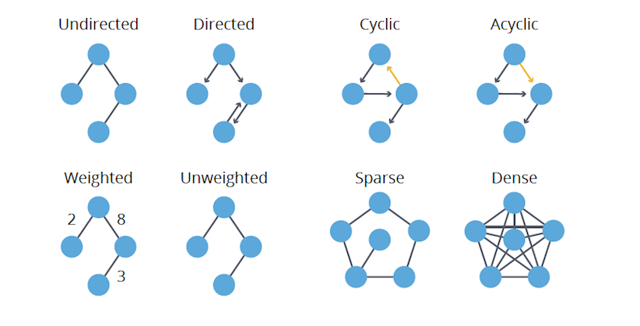
Path Finding Algorithms: Implementation and Analysis
Basic of Graph Theory:
Milan Bista: 2024 Fall - Algorithms and Data Structures (MSCS-532-B01)
Notes:
Path Finding

Slide 8
Path Finding Algorithms: Implementation and Analysis
Path Finding Algorithms:
Pathfinding algorithms are computational methods used to determine the most efficient route
from a start node to a target node within a graph or grid.
The goal is to find the shortest path (or most cost-effective path) considering various factors such
as distance, time, or obstacles.
Breath-First-Search, Depth-First-Search, Dijkstra’s, A* and so on……
The goal is to explore the nodes in an optimal way!!
Milan Bista: 2024 Fall - Algorithms and Data Structures (MSCS-532-B01)
Notes:
Path Finding

Slide 9
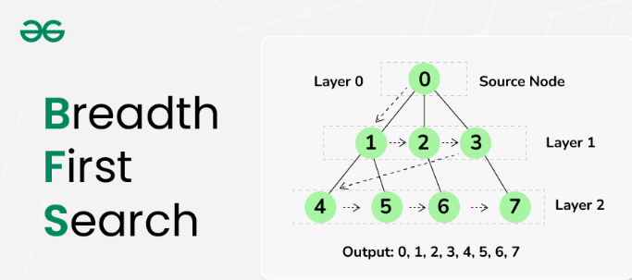
Path Finding Algorithms: Implementation and Analysis
Path Finding Algorithms:
Breath First Search:
is an algorithm used to traverse or search through a graph or tree. It explores all nodes at the
present depth level before moving on to the nodes at the next depth level.
Image Source: GeeksForGeeks
Milan Bista: 2024 Fall - Algorithms and Data Structures (MSCS-532-B01)
Notes:
Path Finding

Slide 10
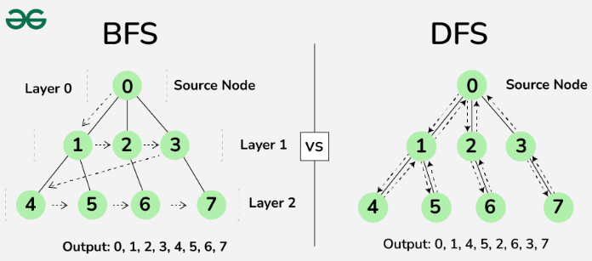
Path Finding Algorithms: Implementation and Analysis
Path Finding Algorithms:
Depth First Search:
is an algorithm used to traverse or search through a graph or tree. It explores as far down a branch
(or path) as possible before backtracking to explore other branches.
Image Source: GeeksForGeeks
Milan Bista: 2024 Fall - Algorithms and Data Structures (MSCS-532-B01)
Notes:
Path Finding

Slide 11
Path Finding Algorithms: Implementation and Analysis
Path Finding Algorithms:
A* Search:
A* is a pathfinding algorithm that combines Dijkstra’s Algorithm with a heuristic to
efficiently find the shortest path from start to goal.
How It Works:
A* evaluates nodes using two factors:
g(n): The cost from the start node to the current node.
h(n): The heuristic estimate of the cost to the goal.
f(n) = g(n) + h(n) is used to prioritize nodes with the lowest total estimated cost.
Pros: Optimal: Guarantees the shortest path with a good heuristic. Efficient: Faster
than Dijkstra’s when using a good heuristic.
Cons: Memory Intensive: Can consume a lot of memory and time with large graphs.
Depends on Heuristic: Poor heuristics reduce performance.
Milan Bista: 2024 Fall - Algorithms and Data Structures (MSCS-532-B01)
Notes:
Path Finding

Slide 12
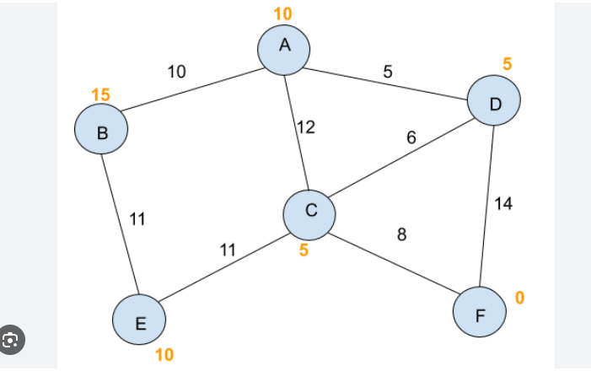
Path Finding Algorithms: Implementation and Analysis
Path Finding Algorithms:
A* Search:
Milan Bista: 2024 Fall - Algorithms and Data Structures (MSCS-532-B01)
Notes:
Path Finding

Slide 13
Path Finding Algorithms: Implementation and Analysis
Visualization with 2D Grid:
I have created a 2D grid using HTML Canvas to visualize the pathfinding process.
Steps:
Create the 2D Grid: A grid of cells is drawn on the canvas to represent the graph, where each
cell can be either passable or blocked.
2.Define Start and Goal: The start and goal nodes are marked on the grid.
3.Run BFS: Using BFS, I will explore the grid level by level, marking the visited cells, until the
shortest path is found.
4.Visualize the Path: Once the path is found, it will be highlighted, showing the optimal route
from start to goal. I will demonstrate Breadth-First Search (BFS) on the grid to find the
shortest path from the start to the goal
Milan Bista: 2024 Fall - Algorithms and Data Structures (MSCS-532-B01)
Notes:
Path Finding

Slide 14
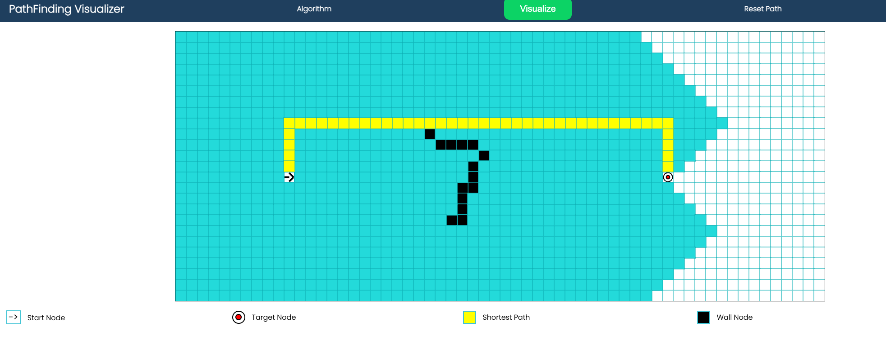
Path Finding Algorithms: Implementation and Analysis
Visualization with 2D Grid:
Url:
https://milanbista.github.io/path_visualizer/
Milan Bista: 2024 Fall - Algorithms and Data Structures (MSCS-532-B01)
Notes:
Path Finding

Slide 15
Path Finding Algorithms: Implementation and Analysis
Algorithm Optimization:
Content:
BFS:
Pros: Finds shortest path in unweighted graphs.
Cons: Slow and memory-intensive for large graphs.
DFS:
Pros: Space-efficient, deep path exploration.
Cons: No guarantee of the shortest path.
A* Advantages:
Optimal: Guarantees the shortest path with a good heuristic.
Efficient: Uses both cost to reach the node and estimated cost to goal.
Faster: Prioritizes the most promising paths, making it quicker than BFS for large graphs.
When to Choose A*:
Use A* for optimality and efficiency, especially in large graphs with
good heuristics.
Milan Bista: 2024 Fall - Algorithms and Data Structures (MSCS-532-B01)
Notes:
Path Finding

Slide 16
Path Finding Algorithms: Implementation and Analysis
Algorithm Optimization:
A* Search Pseudo Code:
A* Search(Start, Goal):
OpenList = [Start]
while OpenList is not empty:
CurrentNode = node with lowest f value
if CurrentNode == Goal: return Path
for each neighbor:
if neighbor not in OpenList or better path found:
Update g, h, f, and set parent to CurrentNode
Add neighbor to OpenList
return failure
Milan Bista: 2024 Fall - Algorithms and Data Structures (MSCS-532-B01)
Notes:
Path Finding

Slide 17
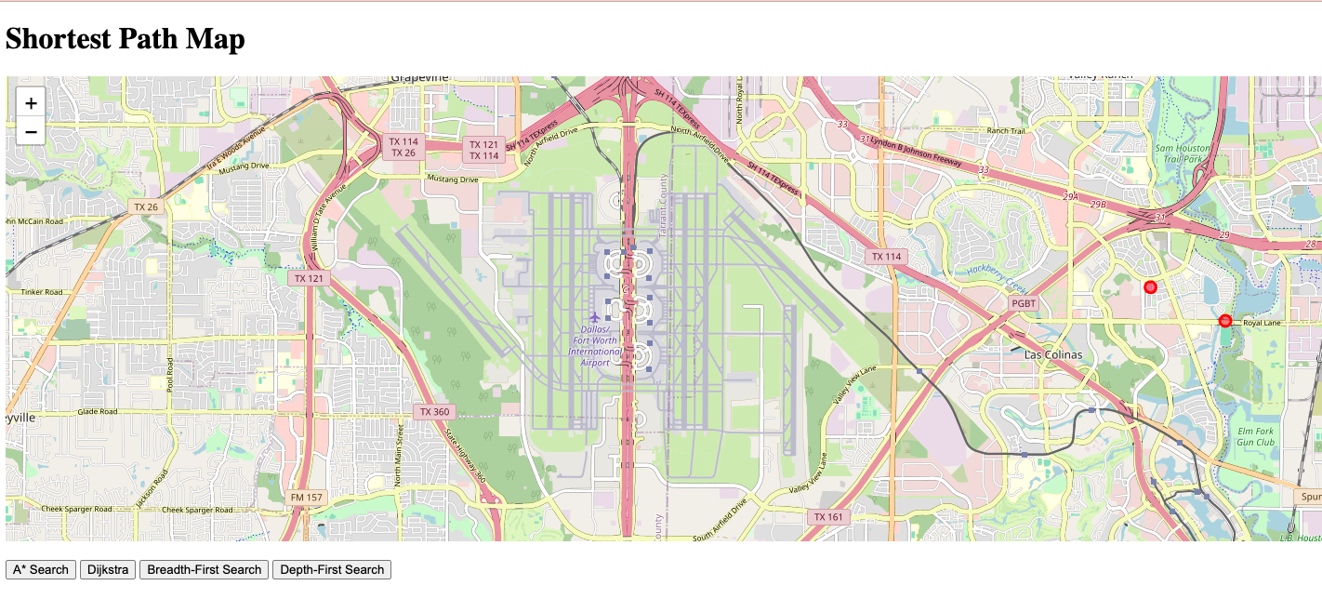
Path Finding Algorithms: Implementation and Analysis
A* Search Demo:
Steps:
Python Flask Application
Algorithms in algorithms.py file and html template for visualization
Downloaded osm file from openstreetmap
Osm limit of 50,000 nodes
URL: https://github.com/mbista25742/MSCS532_Project
Milan Bista: 2024 Fall - Algorithms and Data Structures (MSCS-532-B01)
Notes:
Path Finding

Slide 18
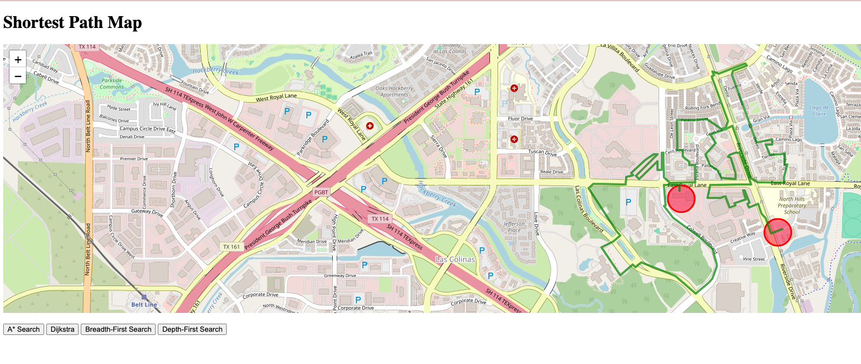
Path Finding Algorithms: Implementation and Analysis
A* Search Demo:
Depth First Search First:
URL: https://github.com/mbista25742/MSCS532_Project
Milan Bista: 2024 Fall - Algorithms and Data Structures (MSCS-532-B01)
Notes:
Path Finding

Slide 19
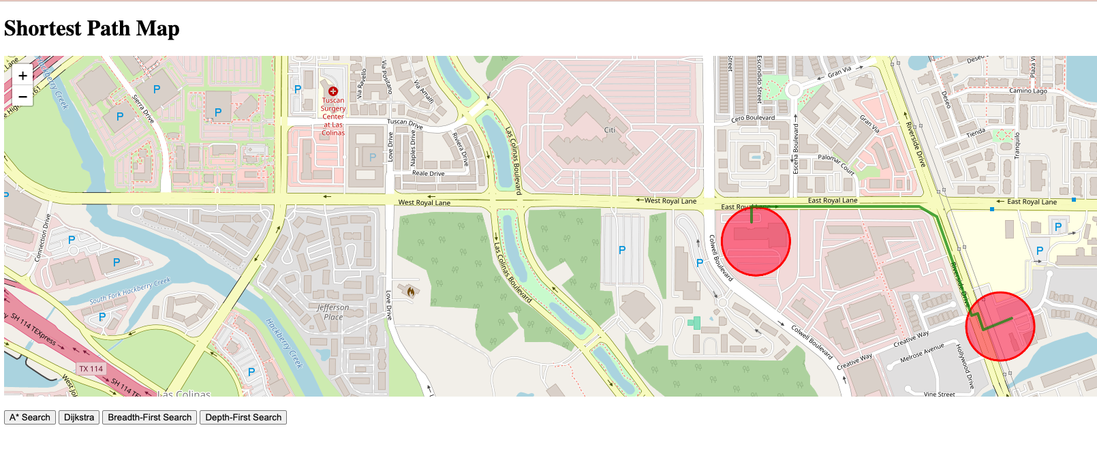
Path Finding Algorithms: Implementation and Analysis
A* Search Demo:
A* Search:
URL: https://github.com/mbista25742/MSCS532_Project
Milan Bista: 2024 Fall - Algorithms and Data Structures (MSCS-532-B01)
Notes:
Path Finding

Slide 20
Path Finding Algorithms: Implementation and Analysis
A* Search Analysis:
Feature | A* | BFS | DFS
Optimality | Guarantees the shortest path | Guarantees the shortest path (unweighted graphs) | No guarantee of the shortest path
Efficiency | High, with heuristic guidance | Low, explores all nodes | Low, may explore deep, irrelevant paths
Memory Usage | High, stores all nodes in memory | Moderate, stores nodes in queue | Low, stores nodes in stack
Best for | Large graphs with a good heuristic | Unweighted graphs, finding shortest paths | Exploring deep, unknown areas
Time Complexity | O(E + V log V) with a good heuristic | O(V + E) | O(V + E) but may take longer in practice
Space Complexity | O(V) | O(V) | O(V)
Milan Bista: 2024 Fall - Algorithms and Data Structures (MSCS-532-B01)
Notes:
Path Finding

Slide 21
Path Finding Algorithms: Implementation and Analysis
Future Research:
Improved Heuristics: Exploring advanced heuristics for more efficient A* search
in complex environments.
Dynamic Pathfinding: A* in real-time applications, such as games and robotics,
where the environment changes.
Memory Optimization: Reducing A* memory usage while maintaining performance.
Multi-Agent Pathfinding: A* for pathfinding in scenarios with multiple agents,
avoiding conflicts and collisions.
Milan Bista: 2024 Fall - Algorithms and Data Structures (MSCS-532-B01)
Notes:
Path Finding

Slide 22
Path Finding Algorithms: Implementation and Analysis
Further Questions:
Open Questions for AI Advancement
1. Big Data & AI:
How can AI efficiently process vast, unstructured datasets?
How to ensure data privacy and avoid biases in AI models?
2. Robotics:
How can robots adapt in unpredictable environments?
How can robots improve collaboration with humans in complex tasks?
3. Autonomous Cars:
How can autonomous cars handle diverse driving conditions?
What are the safety protocols for AI decision-making in critical situations?
Milan Bista: 2024 Fall - Algorithms and Data Structures (MSCS-532-B01)
Notes:
Path Finding

Slide 23
Path Finding Algorithms: Implementation and Analysis
Thank You!!!
Milan Bista: 2024 Fall - Algorithms and Data Structures (MSCS-532-B01)
Notes:
Path Finding

